Slide 1
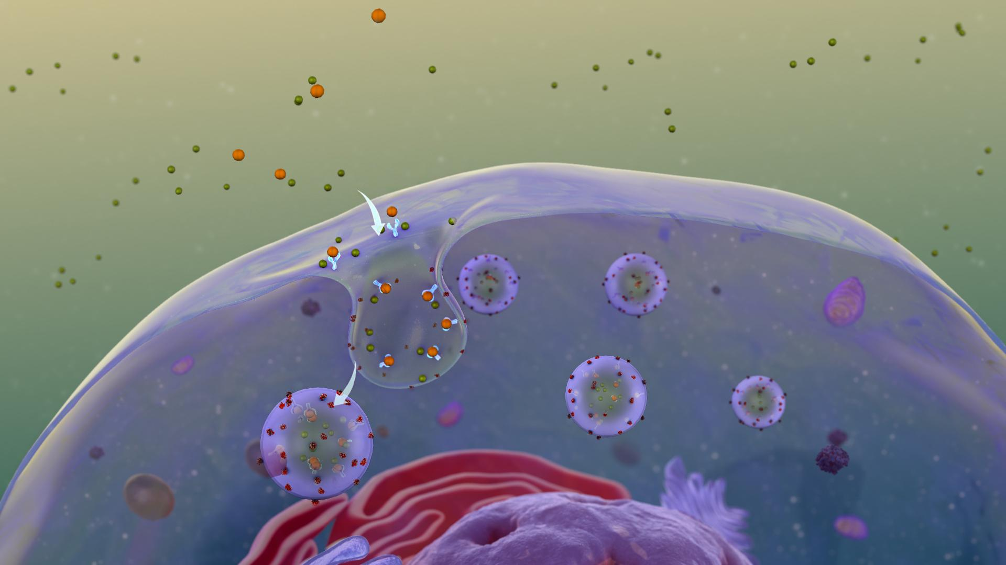
Mechanism of Action (MoA) Prediction
Jaeyoung Kang, Saksham Sarwari, Gautami Kant

Slide 2
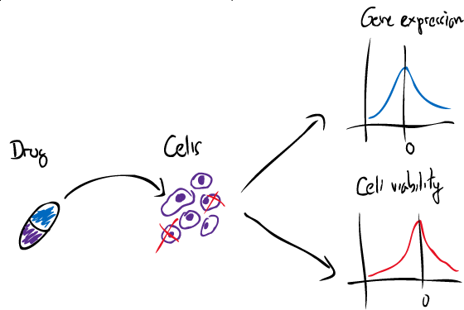
Problem Statement
Earlier, common drugs such as acetaminophen were approved for clinical use decades before biological mechanisms underlying their pharmacological activities were understood
Today, drug discovery has shifted to a more targeted and model-based on an understanding of a disease's underlying biological mechanism
Understanding the mechanisms of drugs is critical to elucidating the clinical significance of a chemical
Using this dataset, we aim to use various metrics detailing the biochemical pathways and medical implementations by which these drugs work
Attributes such as gene expression and cell viability levels of different target proteins in the patient group and dosages given are used to classify drugs into mechanistic categories (eg. agonist, antagonist, inhibitor)
Thus, this problem is a multi-label classification problem: algorithm that classifies drugs based on their biological activity

Slide 3
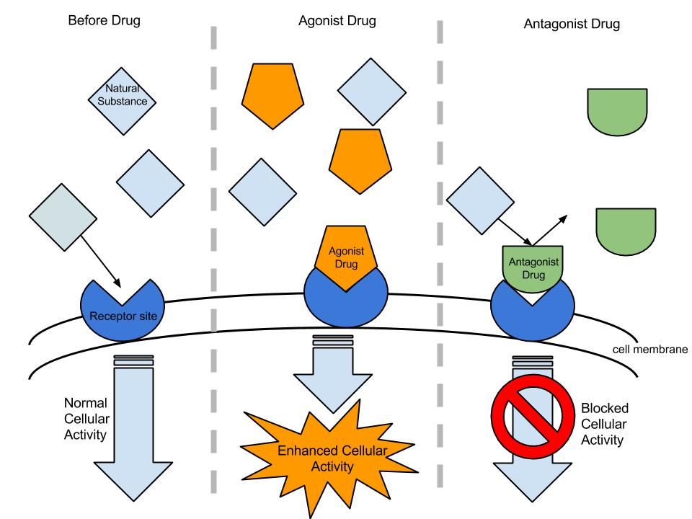
Terminology
3 main words to be aware of…
Inhibitor: Binds to enzyme and blocks substrate
Antagonist: Binds to receptors and blocks ligand
Agonist: Binds to receptors and produces similar activity
https://en.wikipedia.org/wiki/Agonist-antagonist#/media/File:Agonist_&_Antagonist.jpg

Slide 4
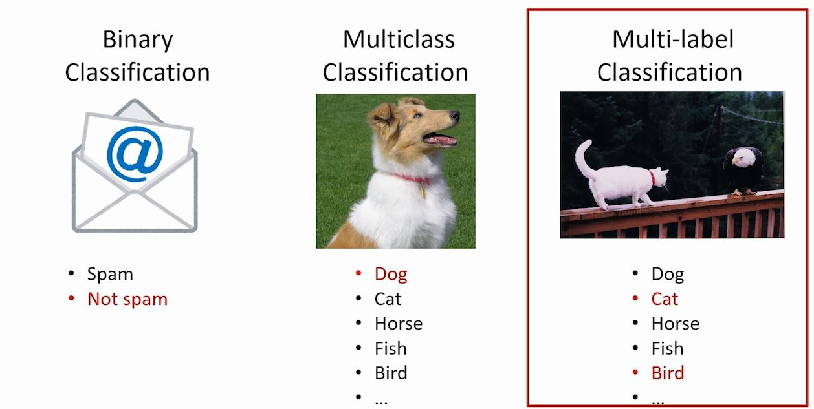

Slide 5
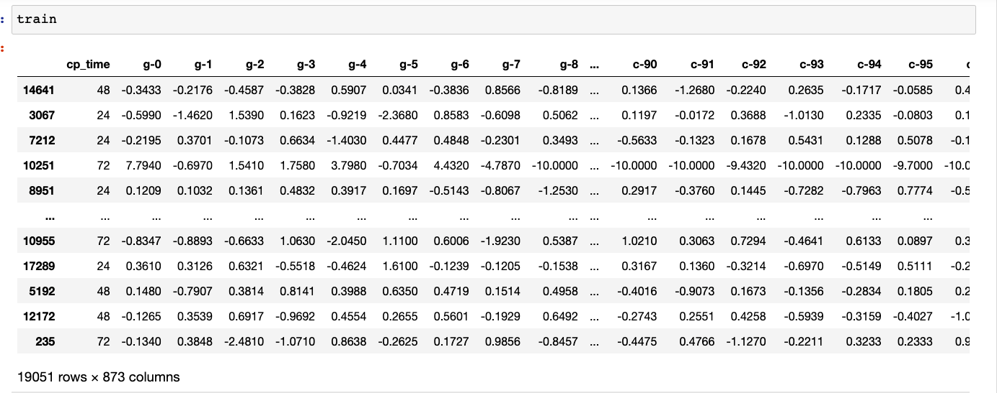
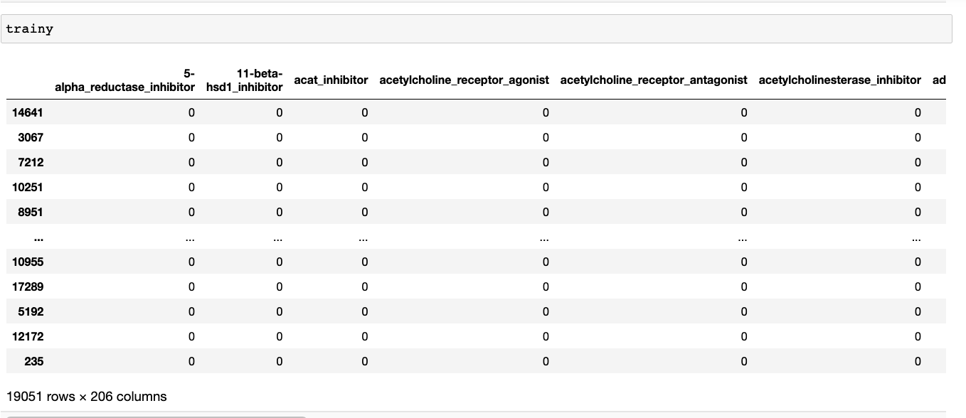
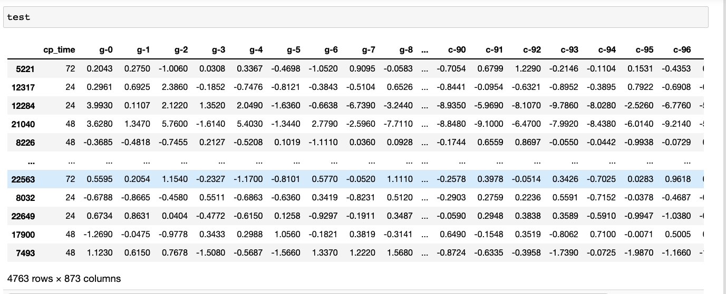
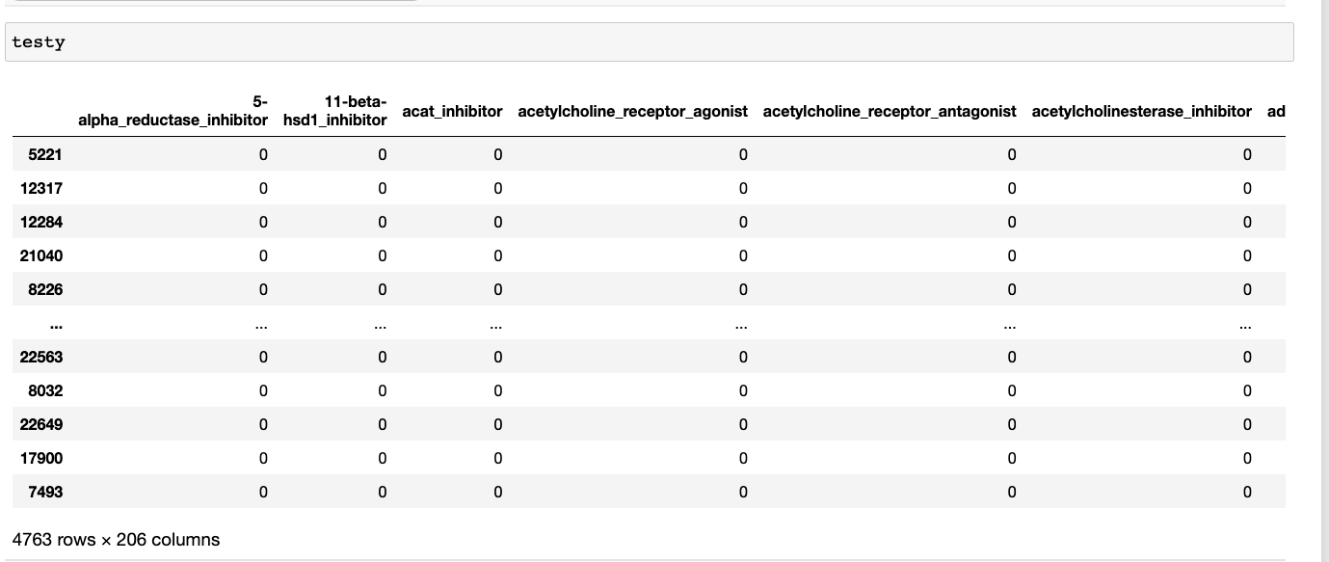
Dataset snapshot

Slide 6
Process Overview
PCA
EDA
Raw
Dataset
Correlation Analysis
Naive bayes classifier
Models
Logistic regression
Random forest
Neural Net

Slide 7
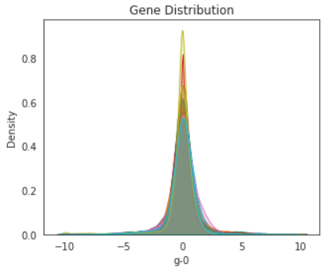
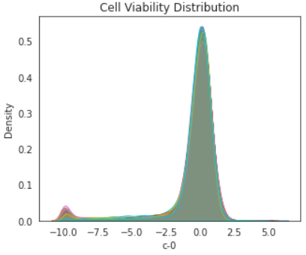
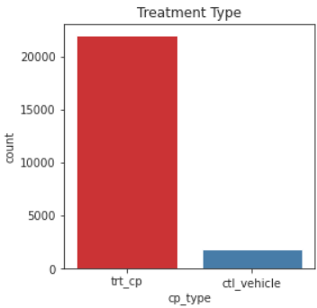
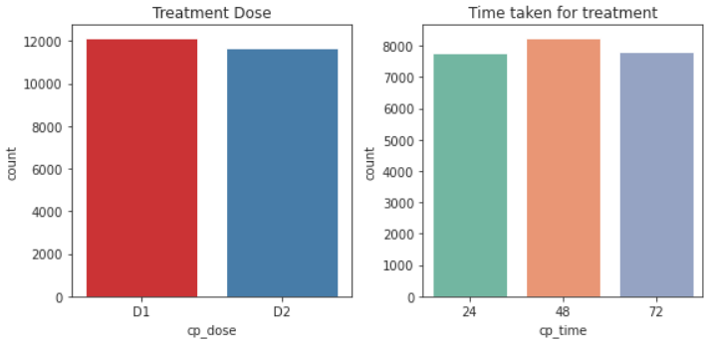
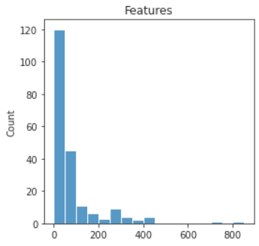
Observations from the Dataset (23814 x 1082)
Gene and cell viability distributions are almost normally distributed with minor exception.
~8% of all records were control treatments (not actual drug treatments). There is no MoA recorded for them
Treatment doses D1 (high) and D2(low) are almost equally distributed. Similarly, treatment times are almost uniformly distributed for 24,48 and 72 hours
~78% of all target MoAs (out of 206) are present in upto 100 observations

Slide 8
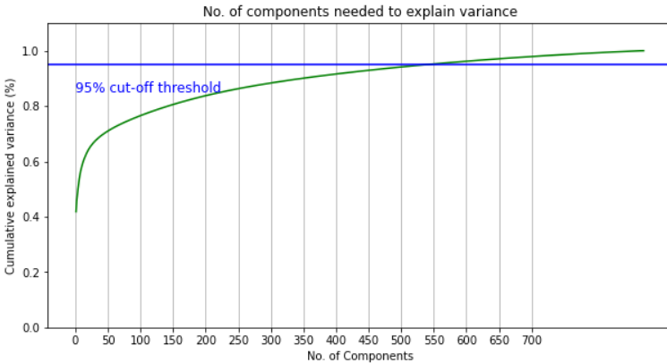
Principal Component Analysis (PCA)

Slide 9
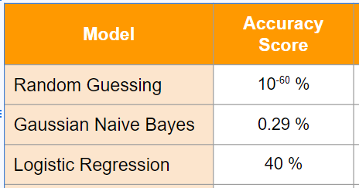
Naive Bayes Classifier
Naive Bayes classifiers are linear classifiers that are known for being simple yet very efficient
Widely used as a baseline for any ML problem and model comparison
Keep in mind that accuracy scores for multilabel classification are subset accuracies…to be “correct”, all entries in a vector have to match up exactly (more on this in a bit)
Notes:
206 predicted labels

Slide 10
Results
Kaggle Metric
Model | Accuracy Score | Hamming Loss | F1 Score | Mean Log Loss
Logistic Regression | 0.4 | 0.0043 | 0.26 | 0.03
Random Forest | 0.45 | 0.003 | 0.13 | 0.017
MLP Neural Classifier | 0.5 | 0.0028 | 0.28 | 0.041
Gaussian Naive Bayes | 0.0029 | 0.49 | 0.09 | 16.1
Keep in mind that accuracy scores for multilabel classification are subset accuracies…to be “correct”, all entries in a vector have to match up exactly (more on this in a bit)
https://www.kaggle.com/competitions/lish-moa/leaderboard

Slide 11
Parameters Used / Some Details on Analysis
80 / 20 split (19051 / 4763)
Ended up using 873 predictor variables to predict 206 labels (different mechanisms of action)
Had to only use the training set provided by Kaggle
Had to install some new packages (sk multilearn)
Random forest: 100 trees and depth of 10
Neural net: 1 hidden layer, tried node count up to 1000 starting from 100 and going up by hundreds

Slide 12
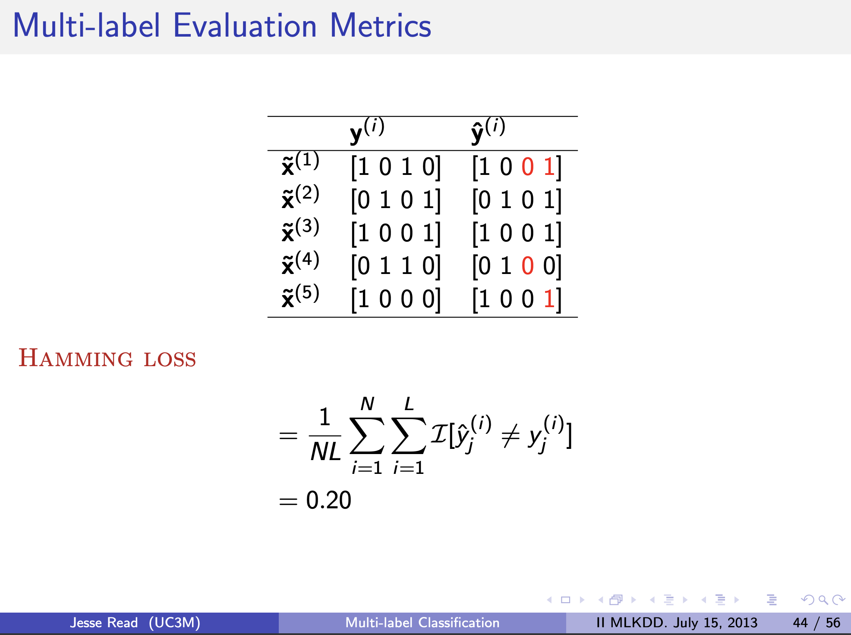
About Interpreting the Results
Which metric is actually the appropriate one?
In subset accuracy, the entire vector has to match up - overly strict
Hamming loss and mean log loss might be better metrics
https://users.ics.aalto.fi/jesse/talks/Multilabel-Part01.pdf

Slide 13
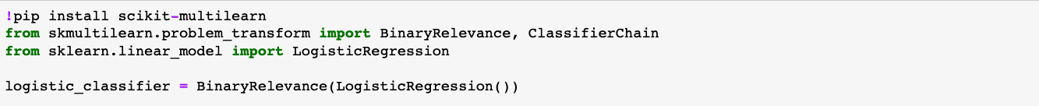
Multilabel Classification on sklearn
Some algorithms can do it by themselves (eg. random forest, neural nets)
You can also use scikit-multilearn if you want to use other algorithms (eg. logistic regression)

Slide 14
Key Takeaways/Outcomes
Multilabel classification evaluation works a bit differently than single label classification
Neural Network based models worked better on this dataset
Label smoothing helps
Notes:
Why NN? The strength of NNs in its ability to figures out features on its own: feature selection and feature engineering is taken care of since NNs are fully-connected.
Whereas the usual models (tree-based, logistic regression…) require a serious amount of pre-processing, feature engineering to have comparable results, especially when you have such a high number of features.
The competition metric punishes highly confident incorrect answers. A simple modification where the labels are smoothed to a small extent, and predictions clipped to prevent prediction probabilities close to 0 and 1 boosts performance significantly

Slide 15
Future Scope
Transforming Non-image data to Images for CNN Architectures

Slide 16
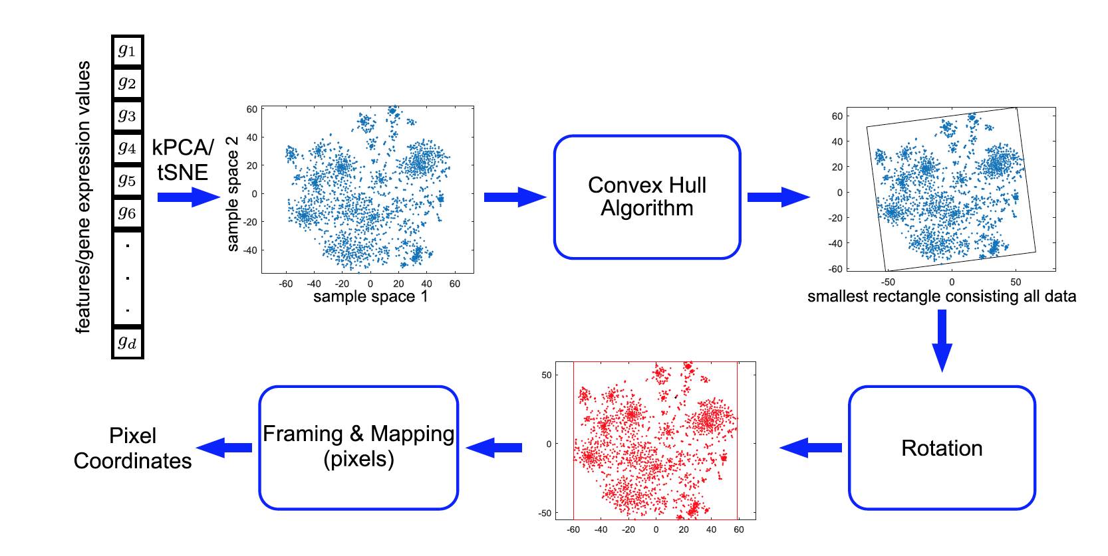
Transforming Non-image data to Images for CNN Architectures
Notes:
First of all, a non-linear dimensionality reduction technique, like t-SNE or Kernel PCA, is applied to transform raw features into a 2D embeddings feature space. Secondly, the convex hull algorithm is used to find the smallest rectangle containing all features and a rotation is performed to align the feature map frame into a horizontal or vertical form. Finally, the raw feature values are mapped into the pixel coordinate locations of the feature map image.

Slide 17
Future Scope
Transforming Non-image data to Images for CNN Architectures
Balance classes using over or under sampling
Use label powerset (Transform multi-label problem to a multi-class problem)
Ensemble and stacking of basic predictor (NN,xgboost, KNN, etc…)

Slide 18


